Slide 1
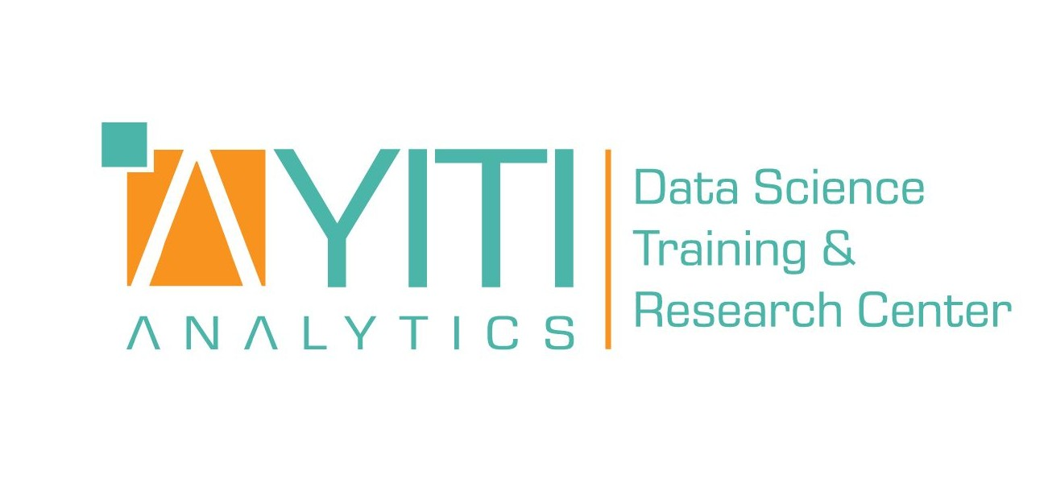

Data Processing Project
Due 23/07/2021
Boutique sales products Analysis

Slide 2
This project is presented by :
VALCIN Pierry
Finance| Data Analyst

Slide 3
Table of content
01
Introduction
02
Problem
03
Methodology
04
Results
05
Discussions & Proposed solutions
06
References & Appendices

Slide 4
Introduction
This project is written as part of a python data processing assignment, in which we was asked to draw out insights as a Data Analyst for Ayiti Analytics from the data they collected on the applicants for their bootcamp.

Slide 5
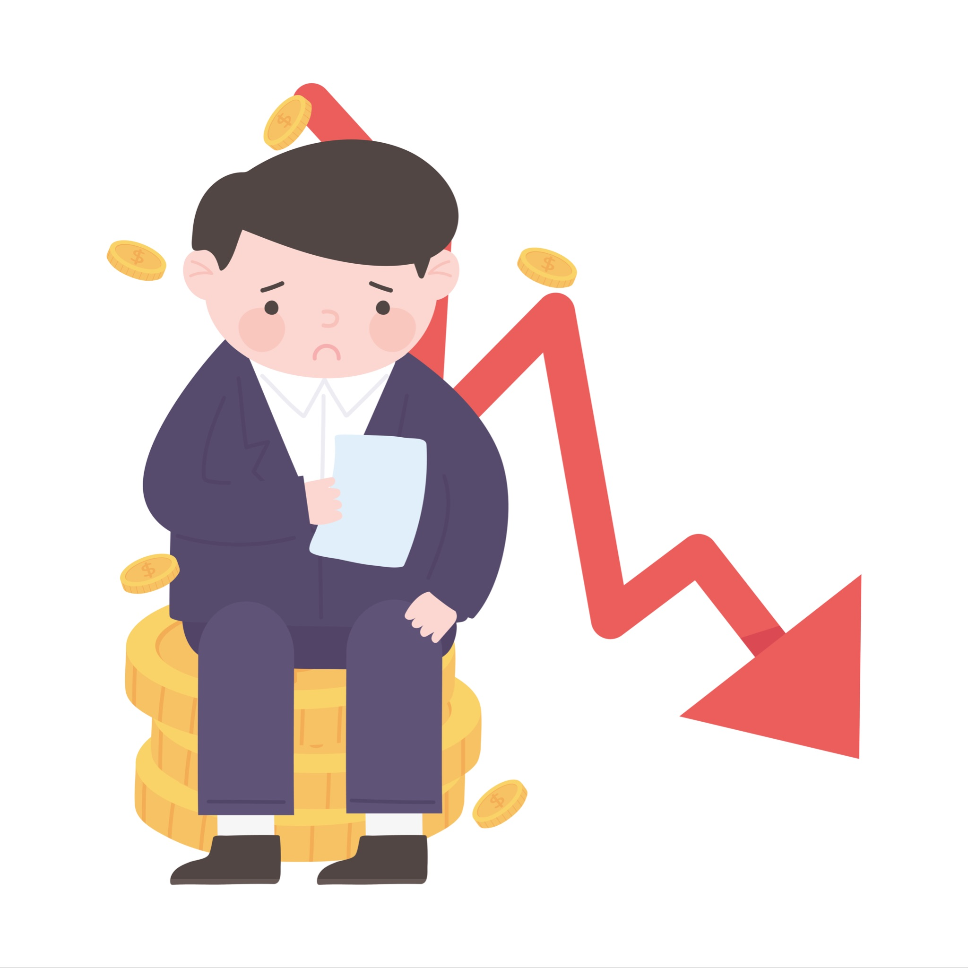
Problem
What is the business problem?
Ayiti Analytics wants to find BA strategy to increase their sales and how to better target applicants from their communications channels.

Slide 6
Problem
Who are the stakeholders impacted by the problems?
The stakeholders affected by this problems are :
The Executive boards of Ayiti Analytics that want to find new strategies .
The applicants : With this problems resolved, more applicants can be reach
Ayiti Analytics Sponsors : New strategies for AA to increase their brands we’ll be beneficial for the Sponsors

Slide 7
Problem
Why is this problem important to the organization?
The problem is important to the organisation because AA wants to be more efficient in how well they will be organize their operations and marketing.

Slide 8
Methodology
To realized this project, we used:
Ayiti analytics Datasets that includes questionnaire forms data ,course enrollment,number of Transactions and industry/study domain
The main tool we used for the data processing is Python. We used it to do the merging of the dataset, data cleaning and also data visualization.
Our approach is Diagnostic Analysis to provide a more in-depth analysis to answer several questions asked by the Executive Boards

Slide 9
Discussion & Proposed Solution
Based on the insights provided by the data processing we did , we can come up with several proposals solutions for Ayiti Analytic’'s problems.
Solution 1
Plan a BA strategy for each communication channel regarding the age group
Solution 2
Plan a BA strategy for each communication channel, Bootcamp Interest regarding the gender
Solution 3
Plan a BA strategy to increase our sales

Slide 10
Plan a BA strategy for each communication channel regarding the age group
Do content marketing
Content marketing is a marketing program that centers on creating, publishing, and distributing content for your target audience -- usually online -- the goal of which is to attract new customers.
The application process for the bootcamp is 100% online.
The announcements were made on the social networks of Ayiti Analytics. 56.4% of the applicants say they heard about AA via social networks and 26.8% of the applicants hear about AA from their friends who might also have heard about it on social media, but we don't have enough data to confirm this.
AA has the team and the technology, the next step is to create more content that can attract applicants like a blog post, videos, infographics,newsletters. And also use email marketing to remain in touch with subscribers

Slide 11
Plan a BA strategy for each communication channel, Bootcamp Insterest regarding the gender
Find the right approach for each gender :
In order to determine the ideal target group, the interest of the target should be taken into account with the insight provided by the dataset,we can assert that there is dependency between the two variables of Bootcamp interest and communication channels .But it is also important to include other factors for a successful campaign. In the case of gender-specific advertising messages, it is important to avoid clichés.
This is especially advisable for gender-related campaigns, such as Women’s Day. Women are particularly well-received if the content is conveyed by emotions, people or family. We can assert it with friends and bootcamp alumni being the top communication channels by the women In contrast, male users prefer campaigns with action and competitive situations. The campaign content should also be transferred to the visual level: clear, bright newsletters with an emotional design are appealing to female customers, while men find a rational approach with technical details and comparisons appealing.Whatsapp and friend are the top communicationg channels for men

Slide 12
Plan a BA strategy to increase our sales
1 - Recognize the customer's problems or needs
It all starts with understanding your customers.With the insights obtained,we can see where the bootcamp interest can play a big part with attracting customers. Knowing that the bootcamp could upscale their skills or open doors on the professional world.
2- People Buy Benefits
People don’t buy products, they buy the results that product will give. AA have to start the process of identifying their ideal customer by making a list of all of the benefits that their customers will enjoy by using their products or services.After participating in the bootcamp, the applicants want to Improving their data skills , Finding an internship or start their own company after learning all the job-ready skills

Slide 13
Plan a BA strategy to increase our sales (Part 2)
3- Develop Your Competitive Advantage
You define your competitive advantage, the reason for buying your products or services, in terms of the benefits, results or outcomes that your customer will enjoy from purchasing your product or service that they would not fully enjoy from purchasing the product or service of your competitor. AA is for now the only company providing this services in Haiti, Extending their market should be the next move for them to be able to reach out more young people that loves tech in haiti.(refers to first Python Project)

Slide 14
THANKS
Contact Us
I you have any question about this presentation, Feel free to send us a message in the #help-python channel on slack.
Ressources
See the full project
Data Analysis Method

